Slide 1

Grow Green
A Digital Marketplace for Quality Seeds and Fertilizers

Slide 2
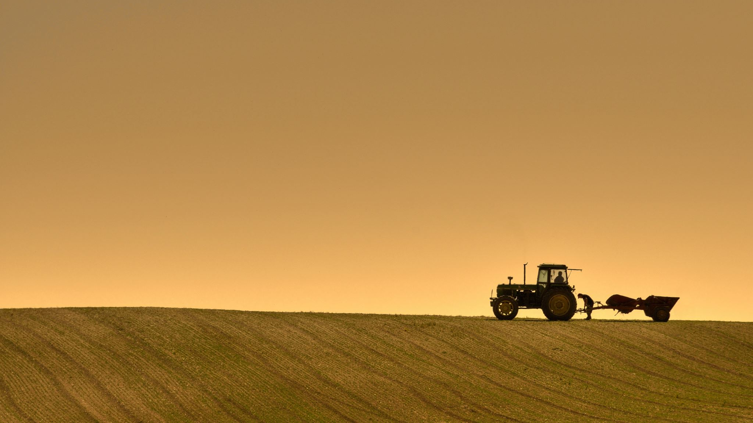
The Challenges Facing Modern Farmers
Limited Access: Difficulty finding high-quality seeds and fertilizers in remote areas.
Price Disparity: Heavy reliance on middlemen leads to inflated prices.
Quality Uncertainty: Risk of purchasing counterfeit or expired agricultural inputs.
Lack of Transparency: No clear visibility on stock availability or fair market pricing.

Slide 3

Bridging the Gap Between Farmers and Suppliers
A unified e-commerce platform dedicated to agricultural inputs
Direct Access: Connecting farmers directly with verified manufacturers and distributors.
Fair Pricing: Competitive rates due to the removal of unnecessary intermediaries.
Quality Assurance: Only certified products listed on the platform.

Slide 4
Seamless Workflow
Farmer registers and searches for products.
Comparison of ratings from different suppliers.
Order Placement via secure payment or Cash on Delivery (COD).
Supplier confirms order and ships via logistics partner.
Delivery to the farmer's doorstep.

Slide 5

Empowering the Grower.
Smart Search: Filter by crop type, season, or brand.
Vernacular Support: App available in local/regional languages.
Reviews & Ratings: See what other farmers say about specific seeds/fertilizers.
Weather Alerts (Bonus Feature): Suggestions based on current weather conditions

Slide 6
Expanding Market Reach
Inventory Management: Real-time stock tracking.
Analytics Dashboard: Insights into high-demand regions and products.
Secure Payments: Guaranteed payouts upon delivery confirmation.
Wide Distribution: Reach farmers beyond the local geography

Slide 7
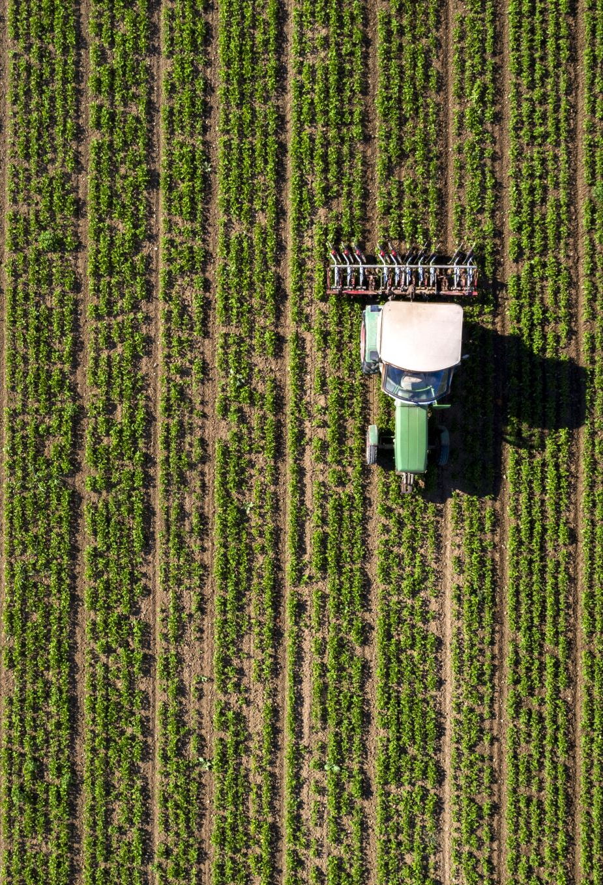
Transforming Agriculture
Cost Reduction: Farmers save money by buying at competitive rates.
Yield Increase: Better quality seeds lead to higher crop production.
Time Saving: No need to travel long distances to visit physical stores

Slide 8

Conclusion
Cultivating a Better Future.
By digitizing the agricultural supply chain, we are not just selling seeds; we are growing prosperity.

